Slide 1
ABILASH NAIR
MRIDUL CHAVAN
SHANMUKHA SURAPURAJU
AKHIL NAGULAVANCHA
AML-
Project Group 2

Slide 2
Retail DSD (Direct Store Delivery) Dataset
DSD is used for delivering perishable products.
Extremely important to maintain and plan delivery schedules to avoid losses
Datasets - Route Data, Store Data and Store Visit Data

Slide 3
RESEARCH QUESTIONS
ESTIMATION OF DELIVERY TIMES FOR ROUTES
MULTI CLASS CLASSIFICATION OF NEW STORES TO WAREHOUSES
LOCATIONS OF NEW WAREHOUSES

Slide 4
FEATURE EXTRACTION
Latitude & Longitude - Stores
Distance travelled on route
Drivers , Loaders, Assemblers - Experience based Potential score
3 categories – 00:00 – 7:00, 8:00 – 20:00 and 21:00 – 24:00
Time taken for each route
Distance of stores from each warehouse
Number of stores a warehouse caters to

Slide 5
EXPLORATORY DATA ANALYSIS & DATA CLEANING
Removed rows where route time was around 5-10 minutes
Removed rows where the route time was really high, but the distance was very short.
Removed unassigned stores
Removed rows where store addresses were missing or erroneous

Slide 6
ESTIMATING DELIVERY TIMES
Features :
Distance – The distance covered on the route ,
Driver Score – Experience score calculated for the driver
Loader Score – Experience score calculate for the loader
Assembler Score – Experience score calculate for the assembler
0 to 7 – If the route started between 00:00 and 7:00
8 to 20 – If the route started between 8:00 and 20:00
21 to 23 – If the route started between 21:00 and 23:00
Time - Time taken to complete the route

Slide 7
Sr No | Model | Train | Test
1 | Linear Regression | 0.9346321623816782 | 0.9338965388667487
2 | Ridge Regression | 0.934632164132487 | 0.9338954512180081
3 | Random Forest | 0.9880434131681542 | 0.9206486475145964

Slide 8
2. CLASSIFICATION OF STORES TO WAREHOUSES
Features :
Lat – Latitude of the store
Lng – Longitude of the store
WXXXX_D * 10 – Distance of the store from 10 warehouses
WXXXX_S * 10 – The number of stores under each of the 10 warehouses within 200 kms
WXXXX_R * 10 – Number of stores already under each warehouse while the store was being inducted
WXXXX_Y * 10 – The target value, one column for each of the 10 warehouses.

Slide 9
Keras Classifier
Neural Network-
1 hidden layer with ReLu activation function
output layer with softmax activation function
loss function - Categorical cross entropy
optimization method - ADAM
KFold cross validation was used to check the accuracy of the model

Slide 10
Model | Accuracy
Keras Classifier | 77.41% (S.D – 1.26%)

Slide 11
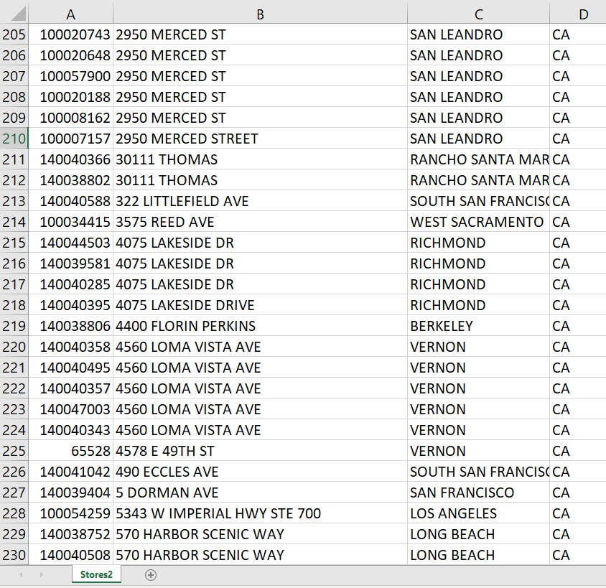
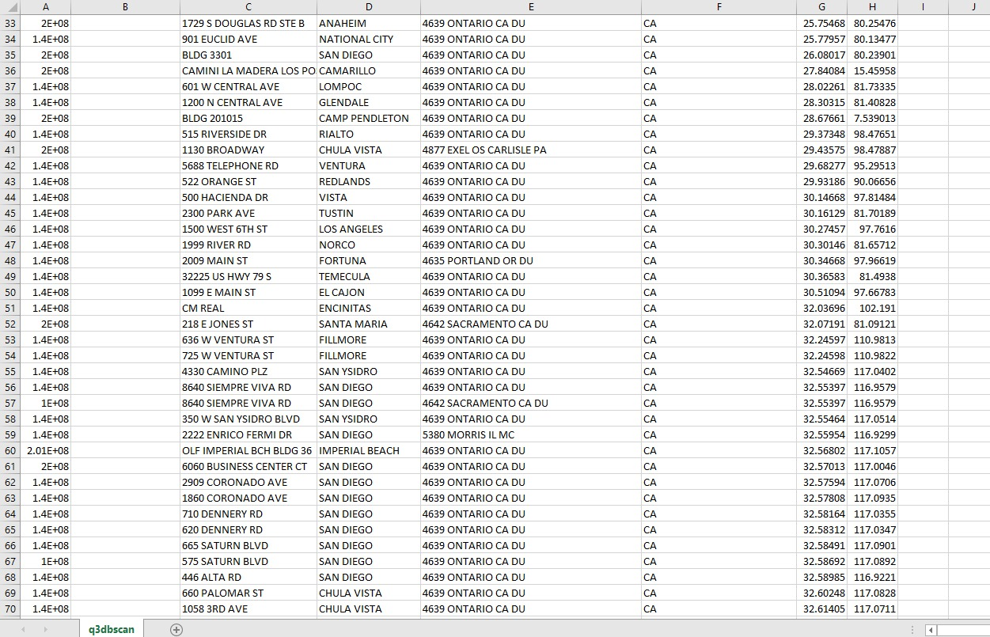
3. LOCATIONS OF NEW WAREHOUSES
Data Preprocessing-

Slide 12
Algorithms considered-
K- Nearest Means Algorithms
Artificial Bee Colony Algorithm
DBSCAN Algorithm
Algorithm finalized and Used-
DBSCAN (Density Based Spatial clustering of applications with Noise)
DBSCAN clusters data considering the maximum distance that can be between the points with in the cluster and the minimum number of points

Slide 13
Labeled Stores and the clusters were formed using the DBSCAN Algorithm taking into consideration, Longitude and Latitude data as features.
Segregated and separated location data for each cluster from the labels.
Used centroid as parameter for considering location nearest to all the stores.
Calculated Centroid for each cluster which we consider as the optimum location for setting a new warehouse for the stores.

Slide 14
RESULT
Two clusters of stores are formed for our data for the maximum allowed distance between stores and minimum number of points to be considered for the clusters we have given.
New warehouse can be setup near the below mentioned locations for the Two clusters formed.
(-75.3197130451613, 40.2878640516129)
(-118.05211866608549, 34.02773298386625)

Slide 15
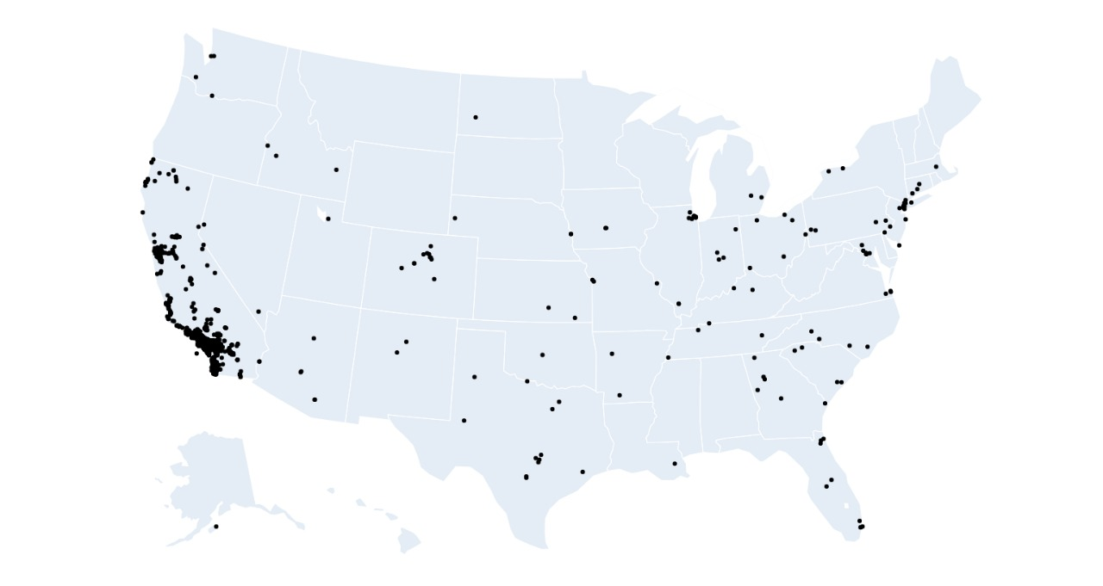
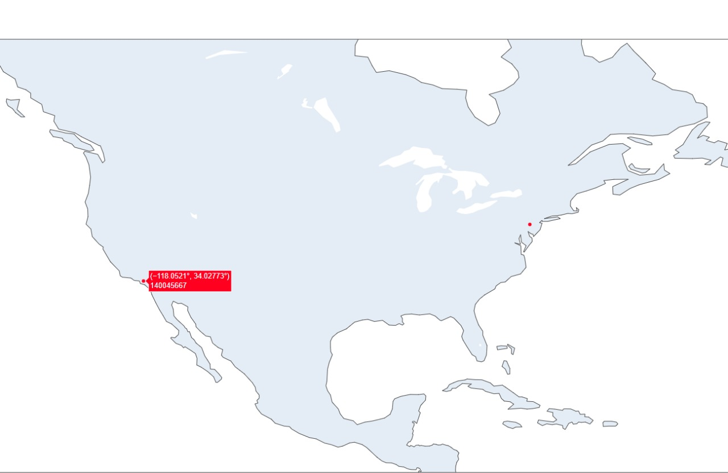
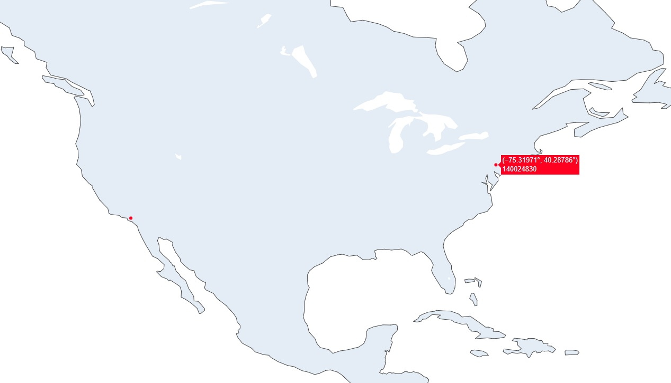

Slide 16
THANK YOU

